Slide 1
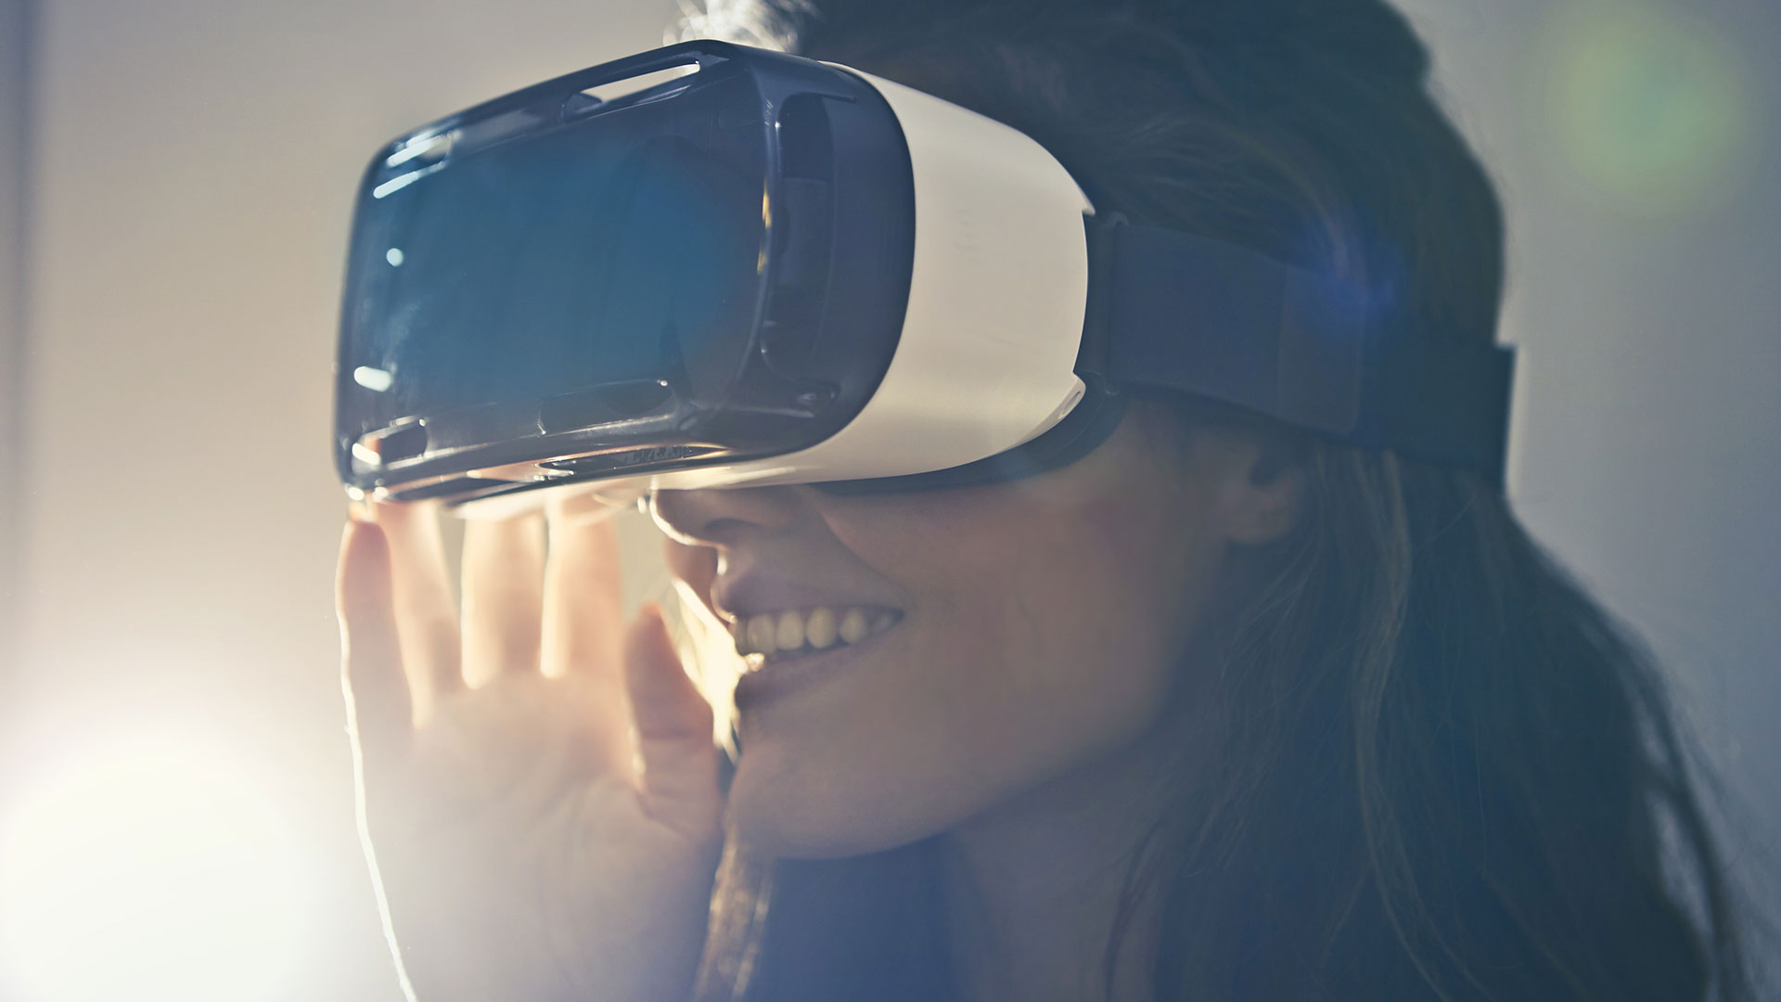
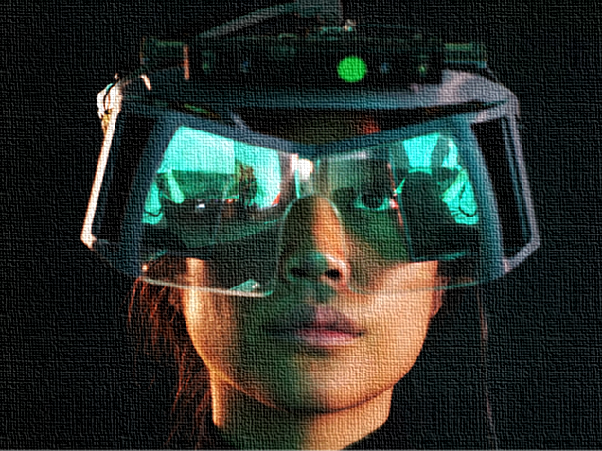
To A Better World
Team 44
Arbey Aragon
Aura Forero
Viveka Devadas
Connecting Charity contributions to Artistic experiences…

Slide 2
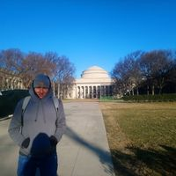
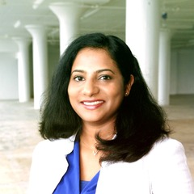
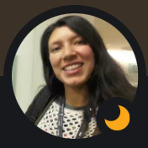
Our Team - XR Enthusiasts Skills: SW Architect, Full stack developer, Technologist
Aura Forero
Arbey Aragon
Viveka Devadas

Slide 3
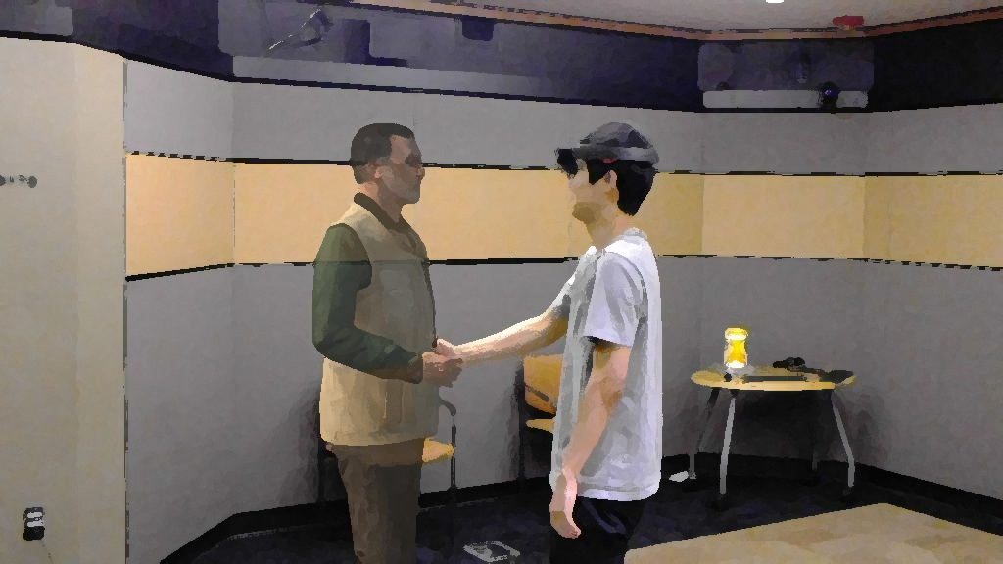

Idea
We want to rise the contributions to charity around the world offering great artistic experiences. We propose an space where people can interact with the avatar of their favorite artist and participate in events by paying and a fee can be paid to an organization or for an specific cause.
To A Better World

Slide 4
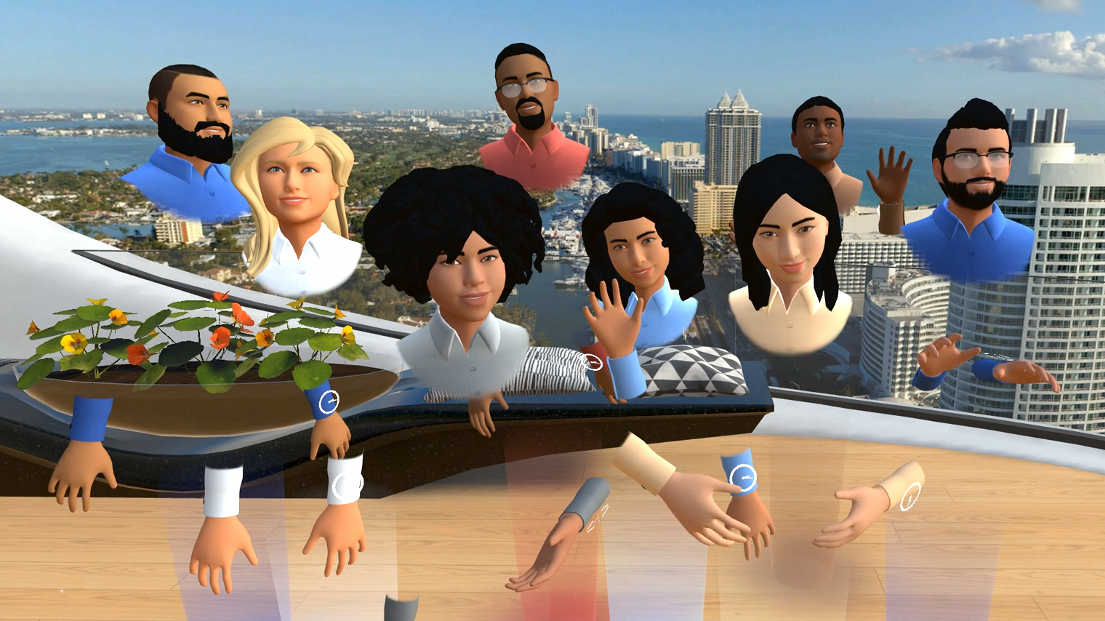
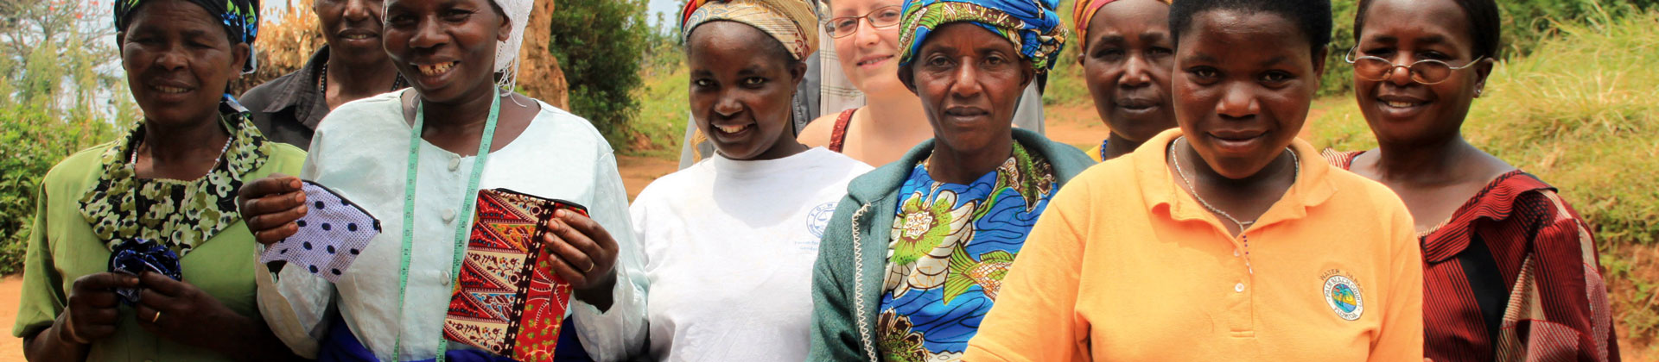
Inspiration
We know about how inequality has grown up around the world, we want to contribute with a tool through which people can interact in a virtual space with their favorite artists and give away to achieve an amount required for a social project, to a Better World.
So, we hope, a kind of equality can be achieved by the aid of social projects in the metaverse.
To A Better World

Slide 5
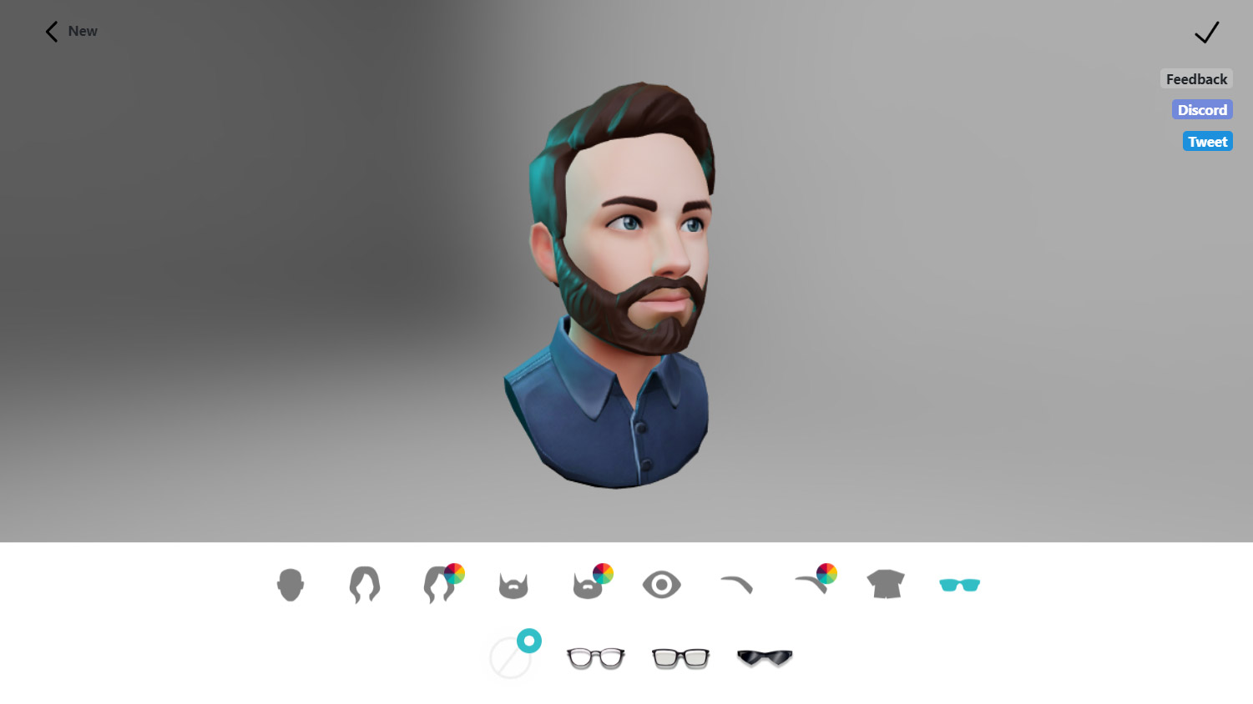
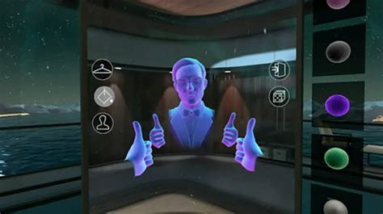
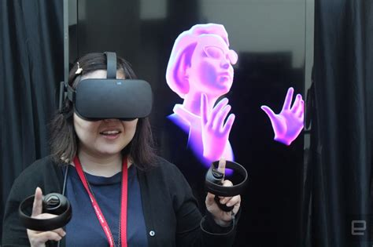


The Solution
1
2
3
4
5
Avatar
Artist Interaction
Participate
Pay Fee
Contribute to Cause
Select the avatar
Select your favorite artist
and connect with
Interact with artist and participate in event
Pay the fee to participate
(Include feature where fans can pay tickets)
Paid to charity organization
(allow organization post social projects to receive support)

Slide 6
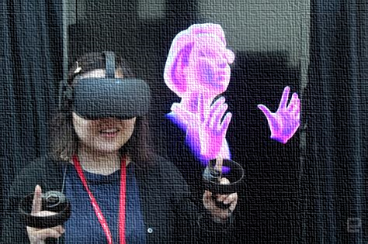
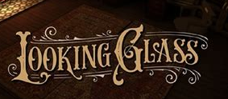





Tools used
Prioritize
Authorize
Contribute
Hardware: looking glass, magic leap one, motion leap
Software: Unity

Slide 7

Challenges Accomplishments
Understand and develop for looking glass portrait.- Smart contract, it is not easy for us to understand all the methodology.
Design the visual part (avatars, images, complete the amount)
Music for the demo. We had no experience as producers or creators of music.
Virtual team collaboration
We learnt a lot about new devices, like looking glass and leap motion.
We believe a better world where collaboration and values can lead improve.

Slide 8


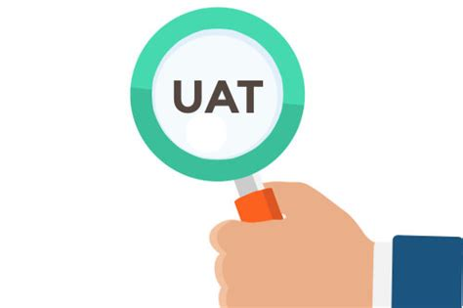
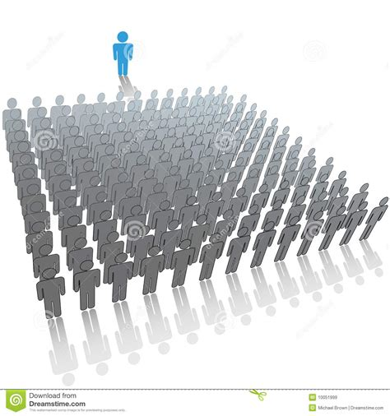
What’s next for To A Better World?
1
2
3
4
Improve development
Ensure two-way integration with tools
Test in small events
Scale it to larger audience

Slide 9
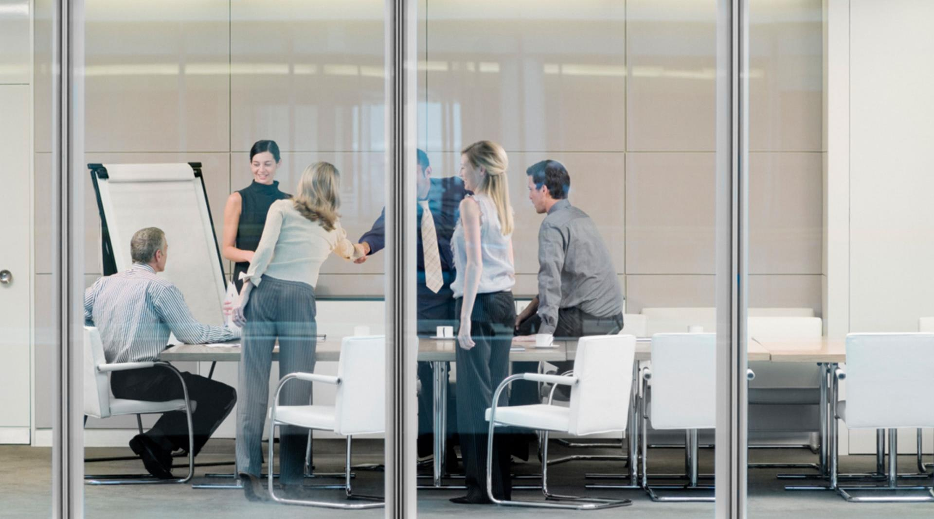
Thank You
Team 44
Arbey Aragon
Aura Forero
Viveka Devadas

